Slide 1
K-Means Algorithm Assignment
By
Htet Aung Lynn (Burmese student)
24-April-2024

Slide 2
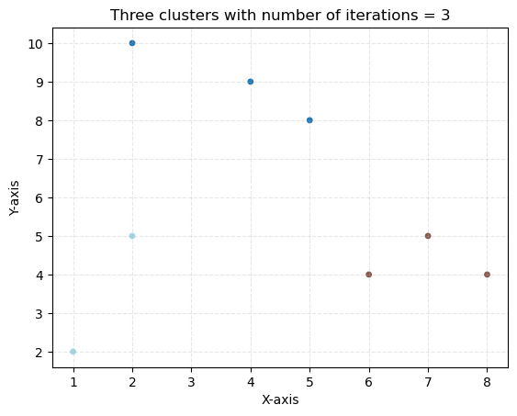
Task 1: Toy Problem
Q1. How many iterations are needed to complete the clustering task?
→ Three iterations are needed to complete the clustering task.
Q2. What is your team’s strategy to stop the iterations?
→ We control iterations using While-loop (< 100 max iterations) and tolerance (>= 0.0001).
Q3. What do the clustering results look like?
→ All three clusters are separately located with their respected points.

Slide 3
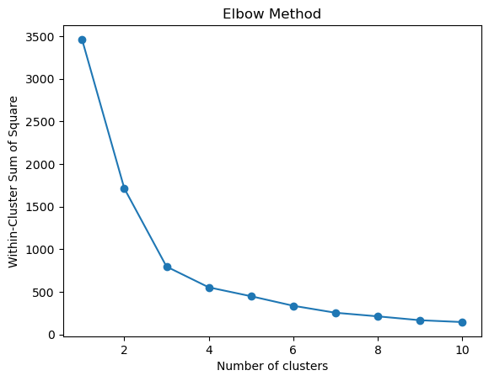

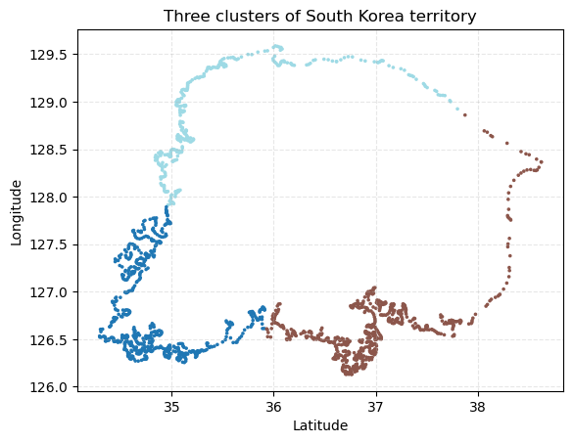
Task 2: Open-ended problem
Q1. What is your team’s strategy to complete the task?
→ Our strategy is to find the number of clusters by using elbow method.
Q2. What does the resulting output look like?
→ The result is as per following
K = 3

Slide 4
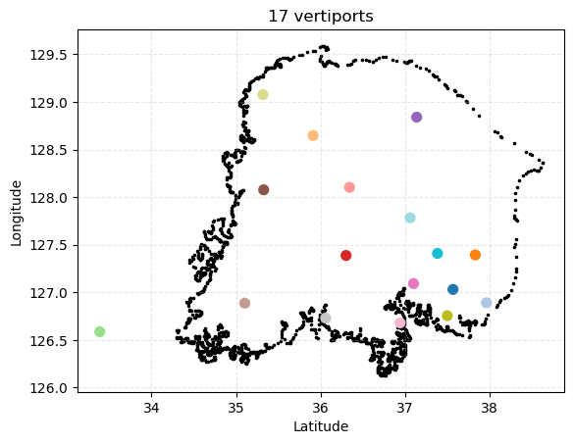
Task 3: Real-world problem (i.e., Vertiport placement) – Part 1
Q1. Let’s say that the Korean government allows your team to assign only 17 vertiports in the Korean peninsula (i.e., K=17). Cluster the vertiport candidate locations using the K-Means algorithm and find the 17 centroid points, which become the final vertiport locations in this scenario.
→ 17 centroids points (final vertiport locations)
Vertiport | Latitude | Longitude
1 | 37.106 | 128.817
2 | 37.033 | 126.961
3 | 35.317 | 129.077
4 | 37.498 | 126.898
5 | 36.065 | 126.729
6 | 37.463 | 127.183
7 | 35.943 | 128.620
8 | 38.074 | 127.108
9 | 37.481 | 126.694
10 | 37.145 | 127.694
11 | 35.103 | 126.886
12 | 33.387 | 126.586
13 | 37.626 | 127.008
14 | 37.826 | 127.410
15 | 37.852 | 126.790
16 | 35.317 | 128.085
17 | 36.269 | 127.480

Slide 5
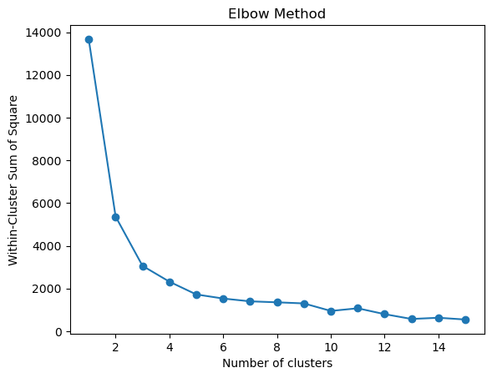
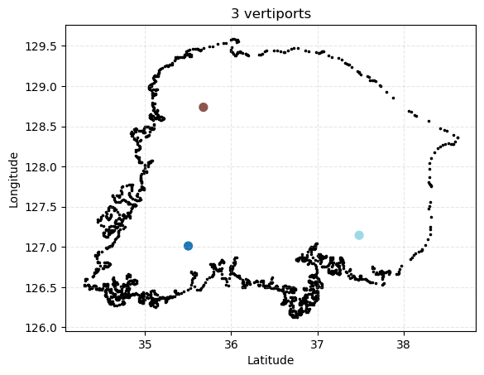
Task 3: Real-world problem (i.e., Vertiport placement) – Part 2
Q2. Imagine that the Korean government allows your team to place vertiports as many as your team wants, implying that the government does not have any financial issues. How many vertiports does your team want to establish in the Korean peninsula? Your team may not want to spend unnecessary building costs (e.g., consider all the given vertiports); but would like to invest money in an efficient manner (e.g., find an appropriate number of vertiports).
→ To be efficient, 3 vertiports are needed to be built as per following locations.
K = 3

Slide 6


References
Chat-GPT Gemini

Slide 7
THANK YOU

